Slide 1
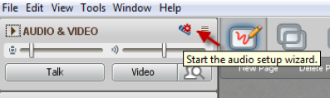
Welcome…
To the 2nd LIVE Collaborate session
FLO – April 23 – 4:00 to 5:00 pm
“Expectations”
While you are waiting…
  Say “Hi!” in the text chat area (left hand side of screen)
  Run the Audio Setup Wizard to ensure your mic works
Revised for April 2015
CC-BY

Slide 2
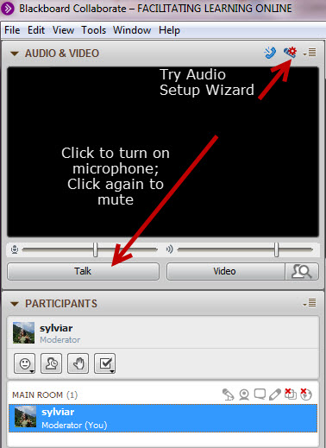
Please note!
This session will be recorded
Please mute microphone unless you are speaking
Get attention by raising your hand
Notes:
Suggest some guidelines for how to speak – mute microphone when not speaking to minimize echo
Raise hand to catch speaker’s attention
Make sure they known that session is being recorded

Slide 3
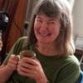
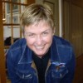

Audio check in
SylviaR
SylviaC
Notes:
Insert profile pics. Ask each participant to “open” their mic, do a brief introduction

Slide 4
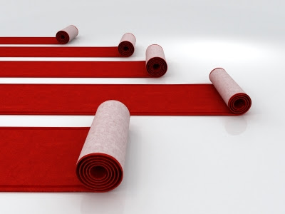
Roles
SylviaC
SylviaR
Notes:
Explain the roles of the FLO Facilitators – overall roles – changing presence during the workshop – participant in planning – taking a role to scaffold the learning that takes place and to assist with posting instructions or providing different Moodle tools/activities

Slide 5
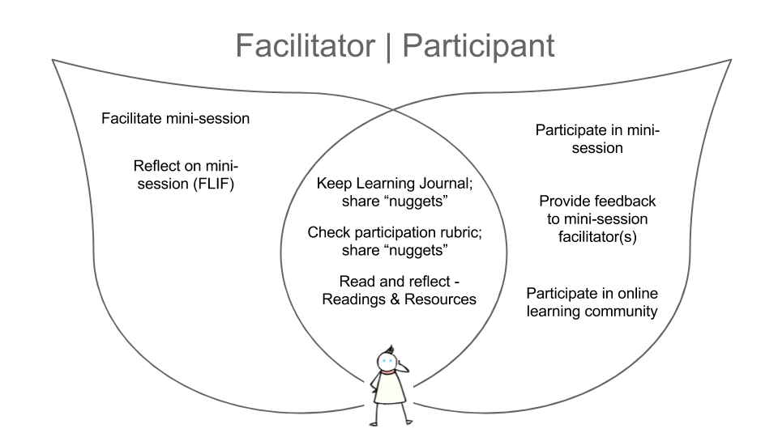
Notes:
Explain the shifting perspective the participants have – what do they do as “learners” and what do they do as more active leaders
Emphasize their roles in relation to the learning activities of the workshop

Slide 6
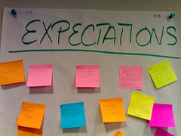
expectations
Notes:
Quickly explain the Whiteboard tools and ask them to type in what their expectations are of the workshop

Slide 7
1
2
3
4
5
hub
Welcome & Orientation
The Online Learner
Online Design
Issues & Tools
Communication
& Collaboration
Looking Back
Looking Forward
Introductions
Demo
Mini-session
1
Mini-session
2
Mini-session
4
Mini-session 6
How Do I…
Online
Community
Building
Mini-session
3
Mini-session
5
Looking Back Looking Forward
Final FLO survey
F.L.I.F.
Feedback
Overview, Readings & Resources
Learning Journal
Self-Assess Participation
Notes:
Use whiteboard tools to emphasize the expectations for participation each week – explain the difference between weekly activities and ongoing activities
This would be a good place to talk about the badges?

Slide 8


Tracking Your Progress
Schedule of Events & Milestones
Learning Journal?
  Any format
  Share “nuggets” weekly in forum
Intended Learning Outcomes & Assessment Criteria
Minimum Requirements – Badges
Self-assessment (FLO Rubric)
Notes:
Explain the importance of critical reflection in the course. They’ll be asked to “track their own progress” They should keep a learning journal and share nuggets each week.
They should consult the ILOs and assessment criteria when they participate/facilitate weekly mini-sessions and other learning activities
They should consult the minimum criteria for earning the two new badges (which affect their successful completion of FLO workshop (and certificate)
The FLO Rubric is the tool that they can use to self-assess their participation each week – this is tied to a final activity in Week 5 where they’ll share their experiences with assessing their own participation and apply that to an exploration of the assessment of students in online learning

Slide 9
Mini-sessions
Adult Learners Online - DEMO
Course Review Task Force
Choosing Your Tools
“Team in Trouble” Facilitating Online Teams
Facilitation Techniques & Strategies
Assessing Participation
Notes:
Explain the reason for our demo; emphasize the importance of keeping it simple when there will be two mini-sessions each week from Week 3-5

Slide 10






Mini-sessions
DEMO – Sylvia Currie, Sylvia Riessner
Names of team members
Names of team members
Names of team members
Names of team members
Names of team members
Notes:
Point out the calendar milestone to connect with their team members. Explain that “connections” should take place in the Planning Forum found in each week

Slide 11
Mini-sessions
Have you…
Connected with your partner(s)
Found your “back pocket strategy”?
Been thinking about the learning outcomes you need to work with?
Got everything you need to move forward?

Slide 12
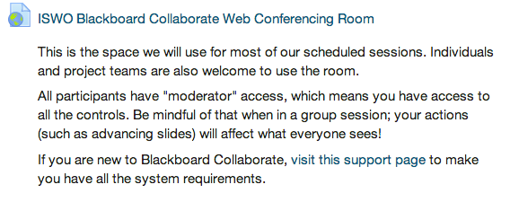
What we all need to know…
We are all moderators (and facilitators) in this space
The room is open 24/7 – link on welcome page
You are welcome to use it any time
You can record your sessions
Notes:
Explain use of Blackboard Collaborate room

Slide 13
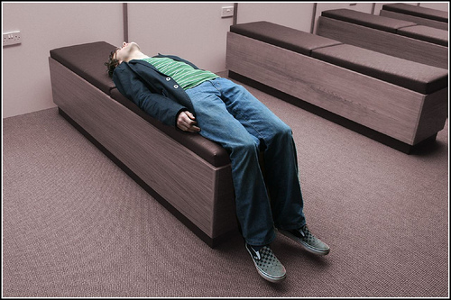
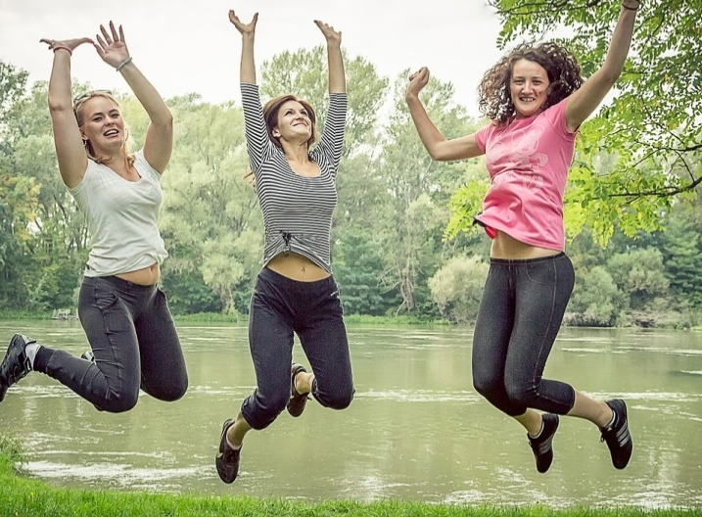
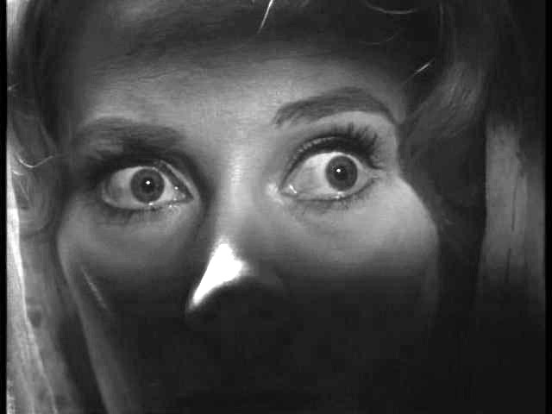
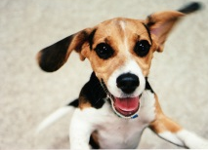
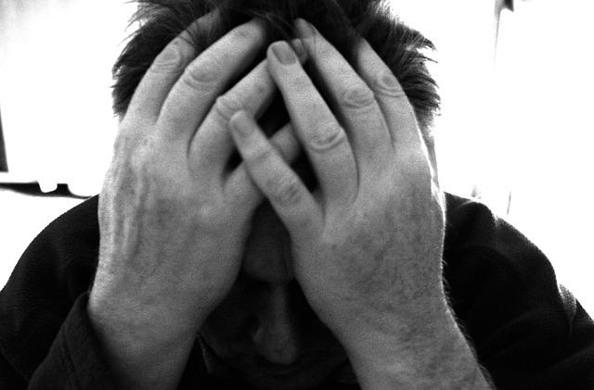
Notes:
Photos by (clockwise beginning at top left:
Ian Sane http://flic.kr/p/9fwoMs
Liam Eldret http://flic.kr/p/63CvE9
zoetnet http://flic.kr/p/6TSHoG
David Goehring http://flic.kr/p/gBnMG3
Martino F. http://flic.kr/p/4BtXE2
Ben Salter http://flic.kr/p/6evMi4 (middle)

Slide 14

Anything else?
Notes:
Photo by Dennis Hill http://flic.kr/p/Lzpyo

Slide 15
About these slides
These slides were developed for use during the first week of the 5-week Instructional Skills Workshop Online
They are based on work developed at Royal Roads University: http://oer.royalroads.ca/
Creative Commons Attribution 4.0 International License
Attribution for images used in these slides can be found in the notes section
Images – Slide 13 Pixabay - Fear – Public Domain - http://simple.wikipedia.org/wiki/Phobia#/media/File:COS_09.JPG
Pixabay - Alone - License: CC0 Public Domain / FAQ
Pixabay – Jumping - License: CC0 Public Domain / FAQ
Flickr – A very excited puppy - https://www.flickr.com/photos/edanley/3246241416/

