Slide 1

Welcome to FLO
How to get started…
Notes:
Welcome to Week 1 of the Facilitating Learning Online workshop!
If you haven’t already had a chance to do so, please check out the Overview + Ongoing Activities page.
The Workshop Outline and FLO Schedule are documents you will be returning to frequently; take time to read them carefully and post any questions into the Open Forum or contact us.

Slide 2
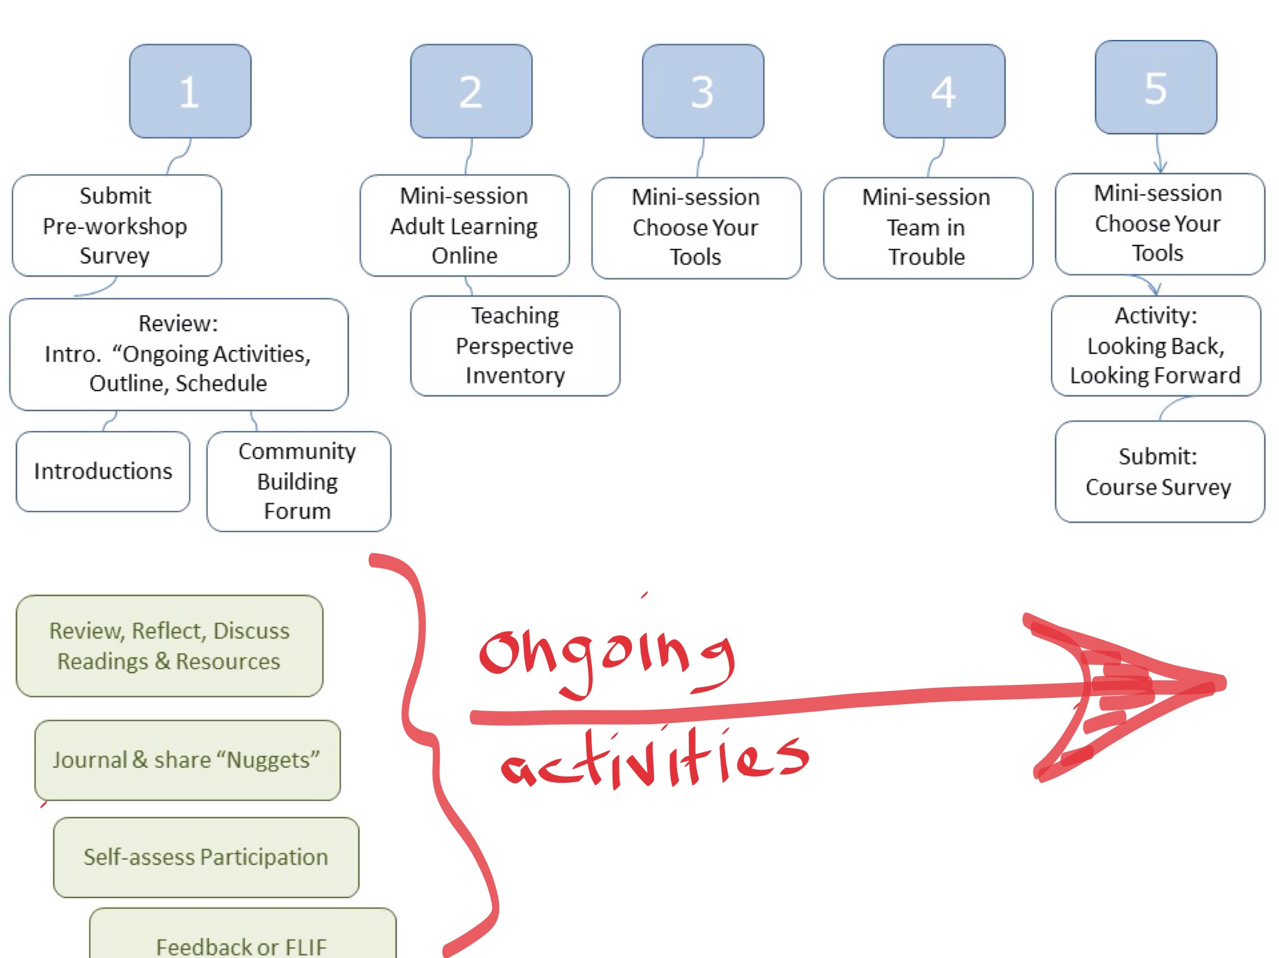
Notes:
The FLO workshop has a rhythm. After week 1, when we get acquainted with the workshop space and with one another, we have a series of mini-sessions facilitated by YOU.
Throughout the 5 weeks, you will attend to some regular tasks. It’s important to keep up with these activities!
You will appreciate, and benefit from, the contributions of others, just as others will benefit from what you contribute.

Slide 3
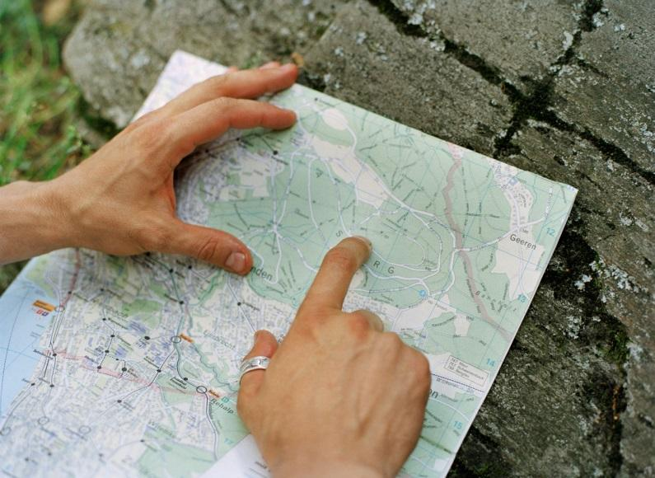
Map out your time
Allow 8-15 hours weekly (more when facilitating mini-session)
Log into course site frequently
Week 1: Feb 16 – Feb 22
Week 2: Feb 23 – Mar 1
Week 3: Mar 2 – Mar 8
Week 4: Mar 9 – Mar 15
Week 5: Mar 16 – Mar 20
Notes:
Some tips to help you organize your time in this course:
Plan to participate frequently.
Schedule time in your calendar.
We suggest 8-15 hours a week but it will vary depending on your familiarity with the topics and when you are facilitating your mini-lesson.

Slide 4

Schedule Time
Course runs Monday – Sunday
Collaborative group activity each week:
  Week 1 – Community Building activity
  Week 2 – Mini-Session 1 - Adult Learners Online
  Week 2 – Mini-Session 2 – Course Review Task Force
  Week 3 – Mini-Session 3 - Choosing Your Tools
  Week 4 – Mini-Session 4 - Team in Trouble
  Week 5 – Mini-Session 5 – Assessment
  Final Class Activity - Looking Back, Looking Forward
Notes:
The workshop is designed to run from Monday to Sunday to allow you to complete work on the weekend when most of you will have more flexibility in how you spend your time.
During each week, be prepared to be involved in a group activity - you may be a participant in a mini-session, a facilitator of a mini-session, or be asked to contribute to a group project (i.e., Week 1).
Mini-Sessions are facilitated by teams – please check your team assignment (in Schedule). If you can’t find your team, please contact us asap (check the Facilitators Contact / Schedule information wiki on the first tab (Overview & Ongoing Activities) or click on the “Participants” link found along the right hand column of the course site.
Introduce yourself in Week 1 in the Introductions Forum right away!

Slide 5

Scheduling Your Time
Ongoing Activities (each week)
  Participate in (or facilitate) mini-session
  Provide feedback (or FLIF)
  Review Readings and Resources
  Learning journal (share nuggets)
  Contribute to open discussion forums
Notes:
There are ongoing activities each week; allow time for them as you plan each week.
During each week, you'll be asked to complete readings, watch videos and then reflect on your learning. The Learning Journal or Blog you set up in Week 1 will be the place to capture your thoughts and questions. Be prepared to share "nuggets" each week in the Weekly Journal Share forum.
Don't forget to check into the Open Forum to review any of the topics under discussion. Feel free to set up a topic thread if you want to explore an idea or question that comes up for you during the week.

Slide 6
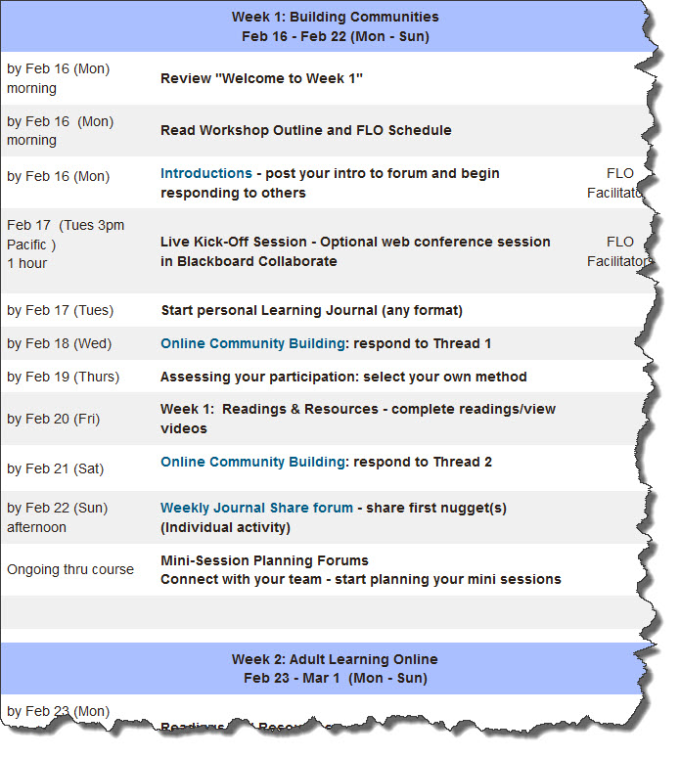
Notes:
Get prepared for Week 1! It will be a full week. Check the detailed FLO Schedule. Make sure you know what to do. We've prepared a quick checklist to help you.

Slide 7
Getting Started
Read Workshop Outline (lots of important stuff!)
Enter important weekly dates into personal calendar
Explore course site (get familiar)
Start on activities for Week 1!!!
Check when you’re facilitating (and with whom)
What is your team colour? Get in touch early!
Notes:
Week 1 is busy; Week 2 is when the teams start facilitating mini-sessions. Week 2 includes two simultaneous mini-sessions; if you’re a participant, you’re expected to participate in both activities. Make sure to contact your team early if you are facilitating in Week 2!
Remember to take a deep breath, relax and go for it. This is a safe, supportive environment where we are all learning together. Enjoy!

