Slide 1
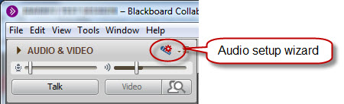
Sound Check: Complete before the session
Hook up your headset
Go through the audio wizard
While you are waiting...Say “Hi!” in the text chat area

Slide 2
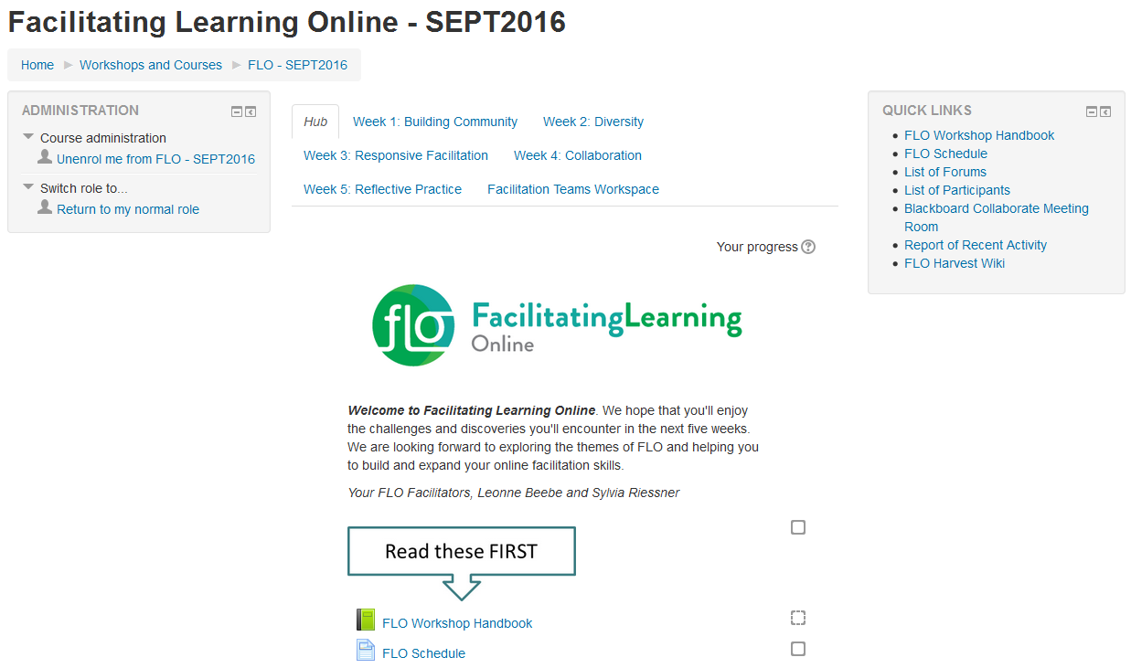
WELCOME TO FLO!
Sept 26 to Oct 28, 2016
Notes:
Personalize with date, embed the FLO logo etc.

Slide 3
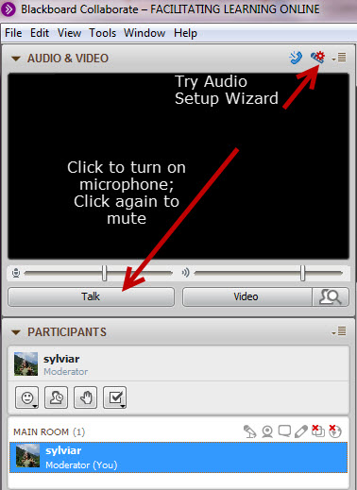
Please note!
This session will be recorded
Please mute microphone unless you are speaking
Get attention by raising your hand
Notes:
Quick housekeeping details-
Sylvia reminds them--raise their hands, turn talk button on. Everyone has moderator access so don’t play right away ;-)
Do a brief hand raise ask of who has been in Collaborate before and who hasn’t. Show them a few things but don’t go into too much detail.

Slide 4





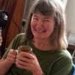


Check in
Bonnie Nicholas
Cheri Macleod
Doug Taylor
Denise Goudy
Judith DeGroot
Claire Clarke
Megan Parrish
Viviana Chiorean
Sylvia
Riessner
Sylvia Currie
Leonne Beebe
Notes:
Populate with profile pics? (Sylvia to add)
Encourage people to add profile pics if they haven’t done so already
Either ask “Share what you see outside your window (or around you)” (name and where they work)
Leonne and Beth introduce themselves very briefly
Or do the “see, hear, smell, touch, taste”

Slide 5

Roles
Leonne Beebe
Sylvia
Riessner
Viviana Chiorean
Notes:
Leonne: Talk about our roles (co-facilitators). Refer to Workshop Handbook - page that explains Roles of FLO Facilitators
In the beginning - very present
After our demo, stepping back so that they can be in the role of facilitator. We don’t generally participate in mini-session (as learners) although we help participants set them up and we may send prompts to the facilitating team during the week if we think support may be needed or participation is flagging.

Slide 6
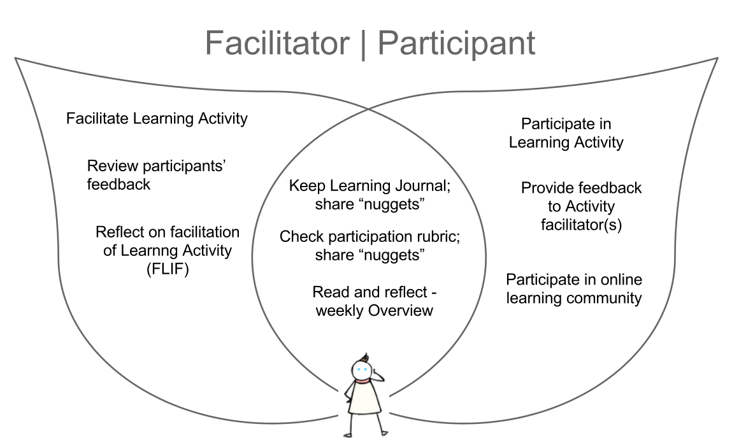
Your Roles
Notes:
Sylvia: point to Handbook – refer to bottom of Weekly Checklist page – briefly talk about basic expectations of participation

Slide 7
Expectations
Notes:
Leonne??: Ask them to share their expectations. What do they hope to achieve? Using the whiteboard participants add their expectations for the session. (tell them a little bit about how to use the whiteboard first)
If no one mentions it, add the expectations of
participation (crucial to support mini-session activities),
communication (let FLO facilitators and other participants know if you have a busy week and can’t be as “present” as you’d like to be),
privacy - although the workshop materials are CC-licensed, what happens in the workshop is private and only shared with permission
Note: If people have any trouble typing on the whiteboard, just ask them to put it into the Chat and we’ll put it onto the white board

Slide 8
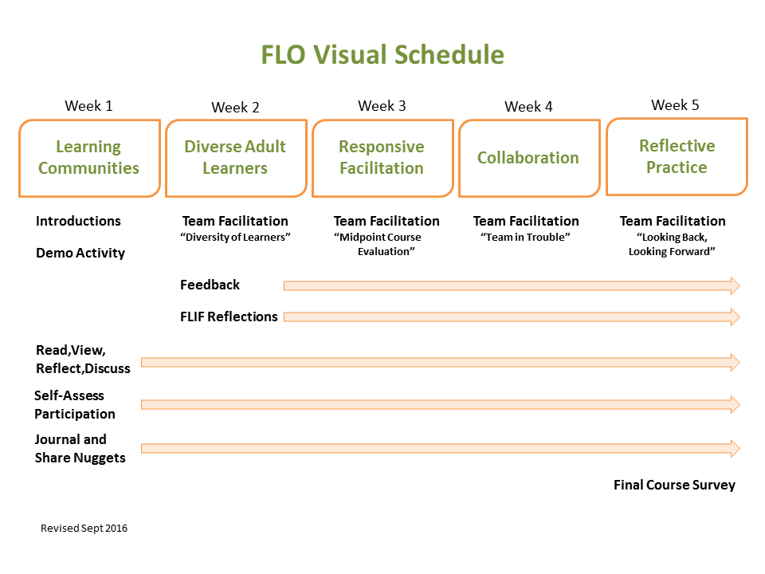
Notes:
Sylvia: Use whiteboard tools ( pen or highlighter) to indicate ongoing activities and to point out sessions – refer to topics in clickable document (refer to Handbook page - Weekly Checklist - also contains visual approach to weekly activities)
“gym analogy” - they have to set their intention to set time aside for the course and follow through...XXX

Slide 9

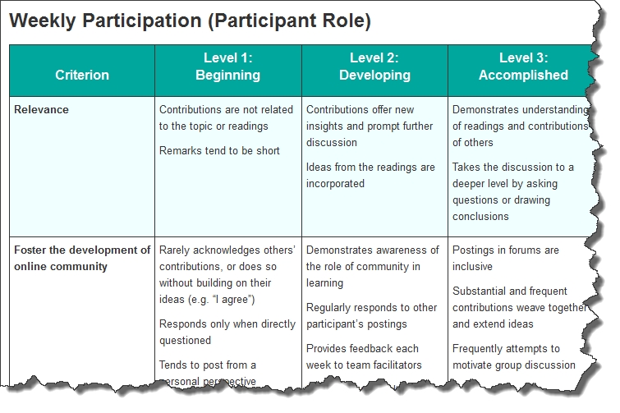
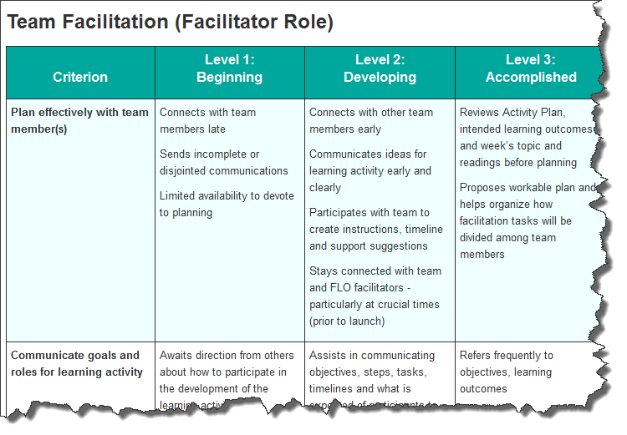
Ongoing Activities
Your personal learning journal
  paper - blog - Evernote - Word doc - other???
Self-assessment
Notes:
Leonne:
Refer to Learning Journal page in Handbook - they should record their thoughts about the week’s experiences, readings/videos, and include some thoughts about the self-assessment rubrics – particular focus on “how is your participation each week?”
Emphasize the contribution of “nuggets” not entire journal entries ;-)

Slide 10
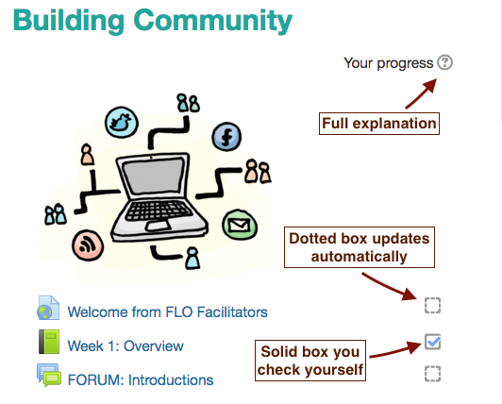
Tracking Progress
Monitor the resources you have accessed and activities you have completed
Some activities have specific requirements, like “post to the forum”.
Once you have satisfied that criteria, a check mark will automatically appear.
Other resources and activities don’t have exact criteria, like the FLO Schedule. You choose when to check that box.
Notes:
SylviaR
We have turned on Moodle completion to help you track your progress – we’ll also post occasional “nudges” in the Open Forum about ongoing FLO activities. The Team that facilitates your weekly learning activity will also provide you with prompts and a schedule with due dates.
The tracking tool also connects to the criteria we use to award you the 3 badges and to earn your Certificate.

Slide 11



Earning Badges
Review Facilitation Team
feedback
Complete FLIF
Contribute to
Looking Back / Looking Forward
Introduce yourself
Provide feedback to
Facilitation Teams
Access FLO Handbook
Share nuggets in
Weekly Journal Share forum
Notes:
Sylvia

Slide 12
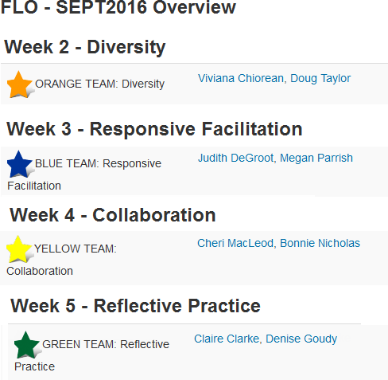
Facilitation Teams
Random team assignments – if you have to switch, post in Open Forum
By WED
Sept 28
Connect early – in Facilitation Teams Workspace page
Activity Plan and Forum for each Team
Notes:
Sylvia: random selection – change by Tuesday night?
Ask them
Have you?
Connected with your team members
Posted your contact information and schedule in Facilitation Teams Workspace
Started to review your Team’s Activity Plan

Slide 13
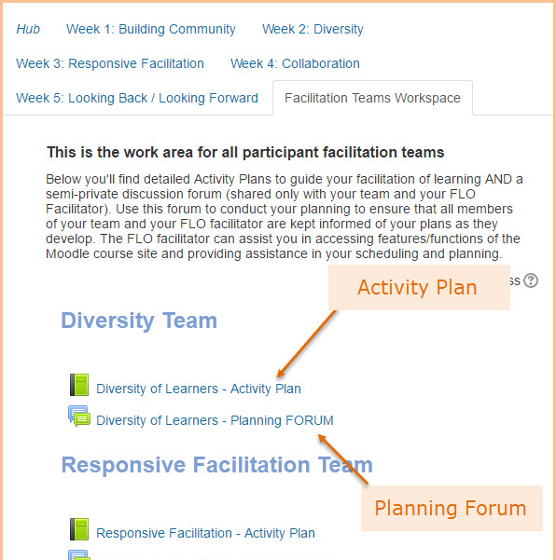
Team Facilitated Sessions
Notes:
Sylvia: Point out the final tab – Facilitation Teams Workspace – contains ILOs, Activity Plan and Forum to plan within.
Ask them
Have you?
Connected with your team members
Posted your contact information and schedule in Facilitation Teams Workspace
Started to review your Team’s Activity Plan

Slide 14
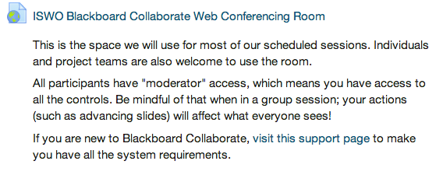
What we all need to know…
We are all moderators (and facilitators) in this space
The room is open 24/7 – link on welcome page
You are welcome to use it any time
You can record your sessions
Notes:
Leonne: mention need to post when using or people could “drop in” unexpectedly

Slide 15
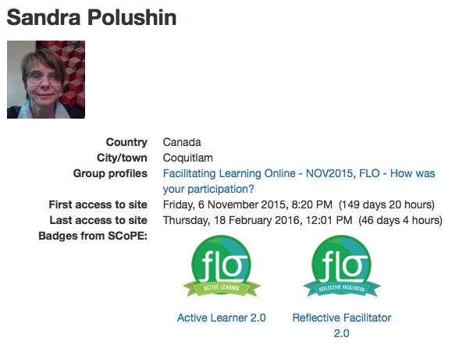
Displaying Badges
Your Name
Badges appear on your profile
Download badges to publish on your own website or blog
Instructions will be posted in the “How do I…? FAQ
Notes:
Leonne?

Slide 16
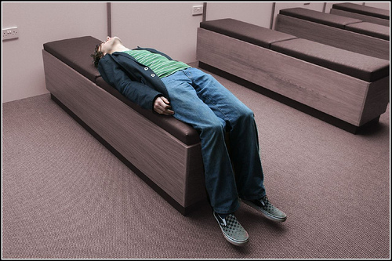
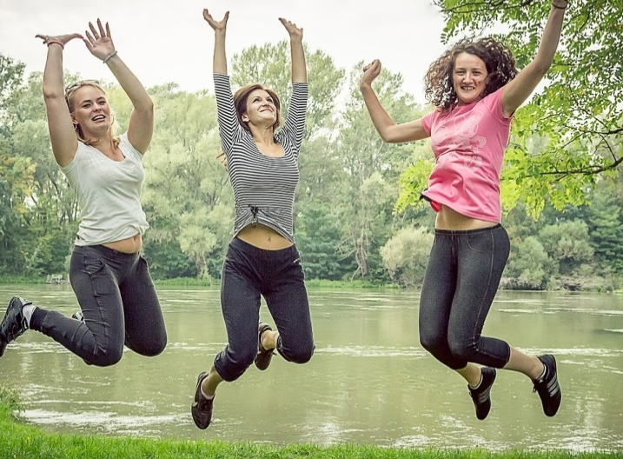
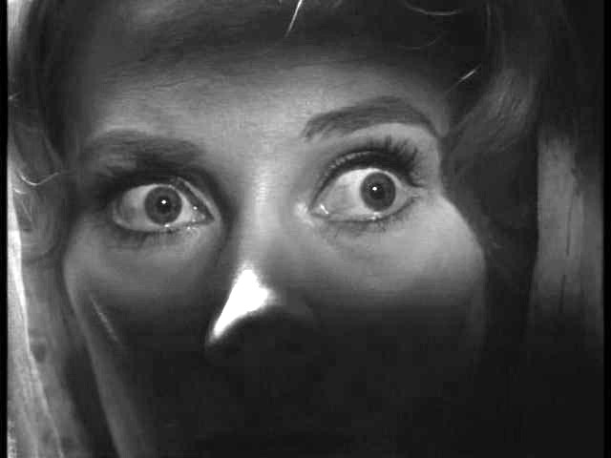
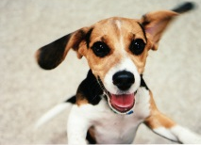
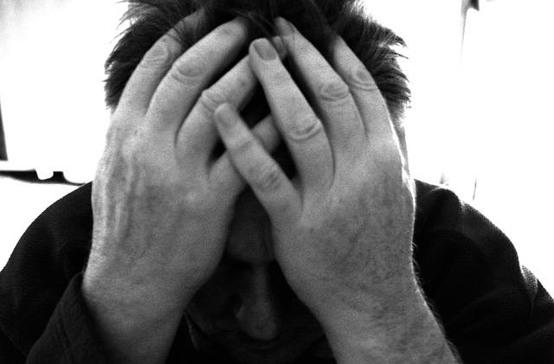
Notes:
Leonne: How are people feeling right now about getting started with this course?
Photos by (clockwise beginning at top left:
Ian Sane http://flic.kr/p/9fwoMs
Liam Eldret http://flic.kr/p/63CvE9
zoetnet http://flic.kr/p/6TSHoG
David Goehring http://flic.kr/p/gBnMG3
Martino F. http://flic.kr/p/4BtXE2
Ben Salter http://flic.kr/p/6evMi4 (middle)

Slide 17

Anything else?
Notes:
Photo by Dennis Hill http://flic.kr/p/Lzpyo

Slide 18
About these slides
These slides were developed for use during the first week of the 5-week Instructional Skills Workshop Online
They are based on work developed at Royal Roads University: http://oer.royalroads.ca/
Creative Commons Attribution 4.0 International License
Attribution for images used in these slides can be found in the notes section
Images – Slide 13 Pixabay - Fear – Public Domain - http://simple.wikipedia.org/wiki/Phobia#/media/File:COS_09.JPG
Pixabay - Alone - License: CC0 Public Domain / FAQ
Pixabay – Jumping - License: CC0 Public Domain / FAQ
Flickr – A very excited puppy - https://www.flickr.com/photos/edanley/3246241416/

