Slide 1
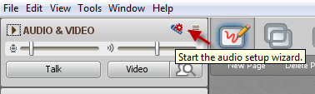
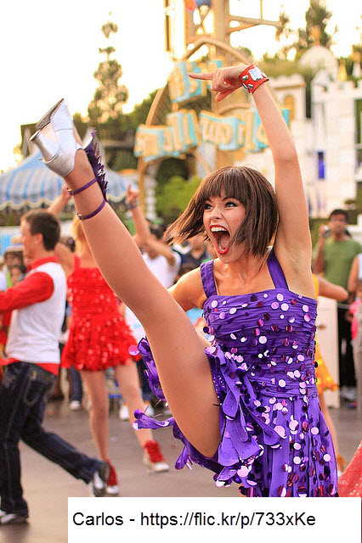
FLO Celebration!
While you’re waiting…
Please run the audio setup wizard
CELEBRATION AND WRAP-UP SESSION
Notes:
RRU FLO May 2016

Slide 2
Who made it?
Notes:
Insert profile images and names of final participants

Slide 3



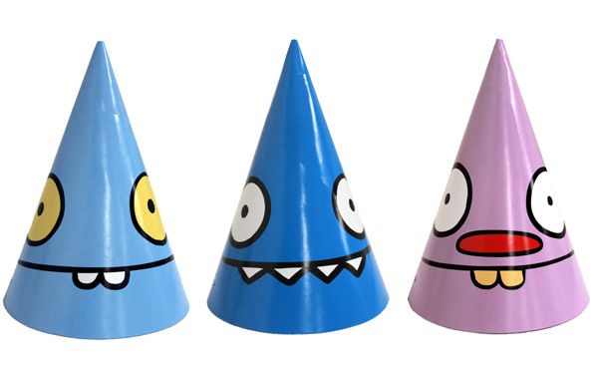
Notes:
Encourage everyone to pick a party hat for the celebration

Slide 4
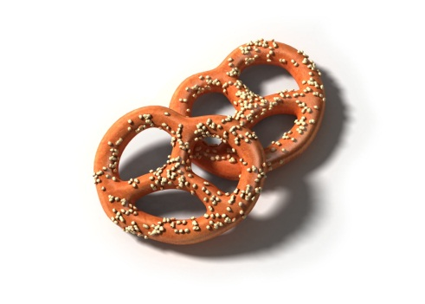
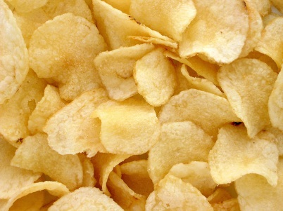
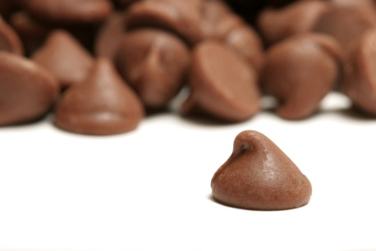
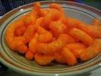
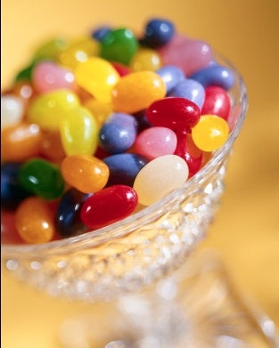

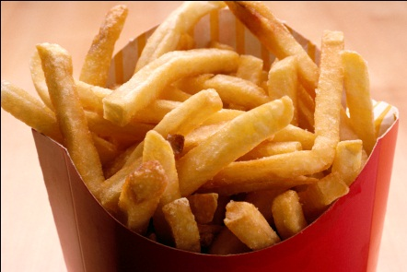
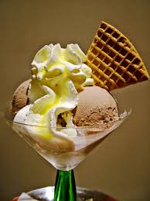

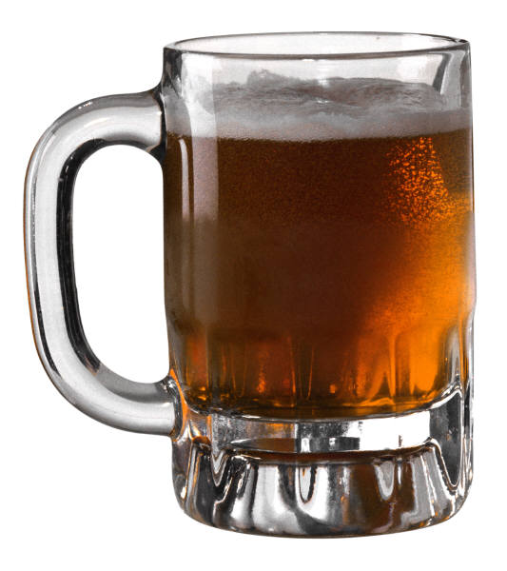
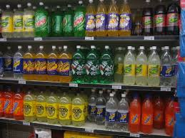

Notes:
http://health.howstuffworks.com/mental-health/human-nature/perception/taste2.htm
Pick a snack/treat/drink for the celebration

Slide 5
Week 1: Who is...
Notes:
create a mini-quiz with easy to remember facts about each participant or only some of the participants who said something funny or who contributed something that made an impression – personal stuff they’ve shared that others commented on (not too personal)

Slide 6



Notes:
Successful guesses get to pick their award

Slide 7

Week 1: Online Community
What comes to mind?
Notes:
Pull out some quotations from Week 1 – or ask people to contribute what stood out for them about Online Community

Slide 8
Week 2: Diversity of Learners
Management of Environment Issues
Social Issues
Intellectual Issues
We need to give each other the space to grow, to be ourselves, to exercise our diversity.
Max de Pree
Notes:
We need to give each other the space to grow, to be ourselves, to exercise our diversity. We need to give each other space so that we may both give and receive such beautiful things as ideas, openness, dignity, joy, healing, and inclusion.
Max de Pree
http:
//www.brainyquote.com/quotes/keywords/diversity.html
Review how the team (put names in stars) structured their activity? Ask team members to talk about the week (if they attend the session)

Slide 9
Week 3: Responsive Facilitation
Notes:
Share some highlights of the week’s mini-session
If team facilitators are present, ask them to briefly share “nuggets” from their experience (otherwise be prepared to share something for them)

Slide 10
Week 4: Collaboration
Notes:
Share some highlights of the week’s mini-session
If team facilitators are present, ask them to briefly share “nuggets” from their experience (otherwise be prepared to share something for them)

Slide 11
Looking Back,
Looking Forward
Notes:
Share highlights of final activity – did they use metaphoric mirror exercise?

Slide 12

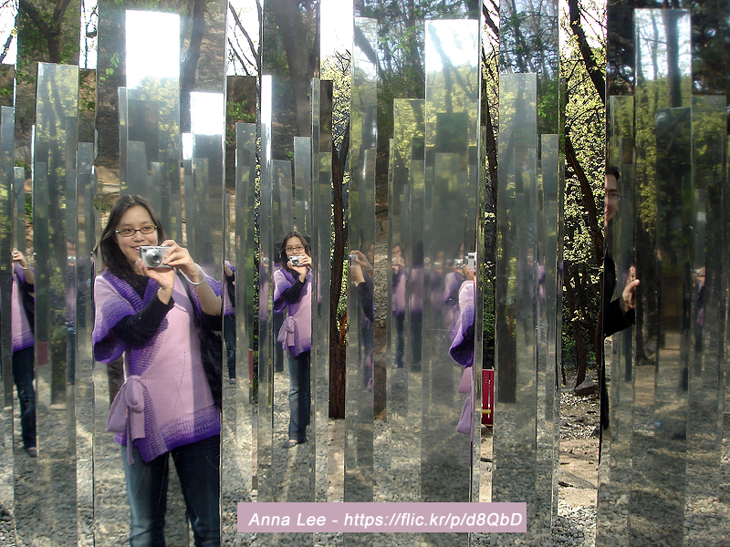


Badges and Certificate
Notes:
Handbook states – multiple methods of reflection and self-assessment
Review process of getting badges (if they want them) and how to apply for a FLO Certificate from Bccampus

Slide 13

FLO/FDO
Community of Practice
Notes:
My fireworks image – Haines, Alaska
Stay in touch – sign up for FDO (now or next time around – it’s free)
Think about starting this in your institution
Stay in touch with us – and the FLO/FDO Community of Practice

