Slide 1
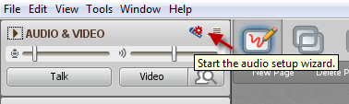
FLO Mid-point Check-in
While you’re waiting…
Please run the audio setup wizard
A chance to ask questions and share suggestions

Slide 2




Check-in…
Notes:
Ask each person to explain their rating briefly

Slide 3
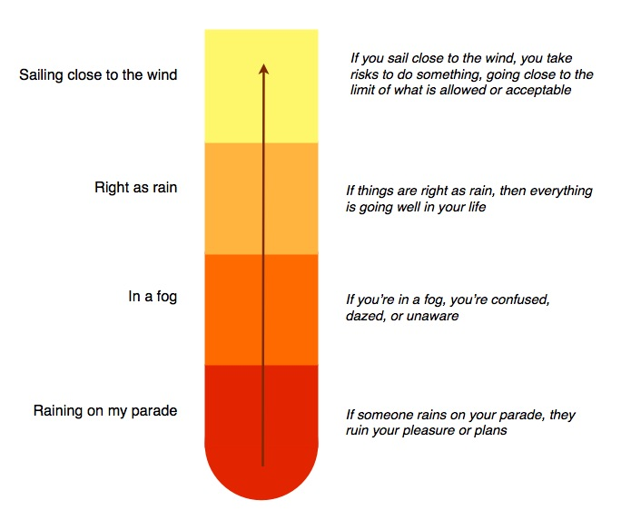
Temperature Check
Notes:
Alternative to my slide above – this one was developed by Beth – we used in Apr 2016 FLO

Slide 4
Success - Challenges…
Success?
Challenge?
Notes:
Ask them to think of 1 success and 1 challenge – share by typing or talking (if talking one of FLO Facilitators should record on slide

Slide 5
Invitation…
What opportunities do you see
to change your online facilitation practice,
as a result of what you’ve learned in this course to this point
Notes:
Think about what you’ve experienced – if there aren’t enough participants to do a 1-2-4-ALL (Liberating Structure) – just discuss in group after 1-2 min to reflect

Slide 6
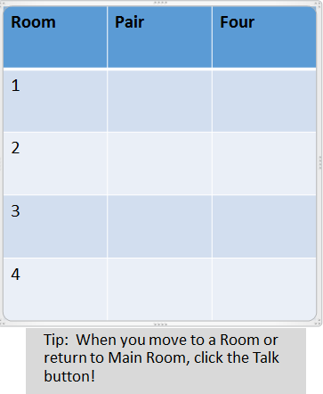
Process…
- Reflection on your own (2 min)
- Move to breakout rooms in pairs (4 min)
- Return to main room
- Move to breakout room in 4’s (6 min)
- Return to main room
- Debrief – whole group
Notes:
If enough attendees, try the Liberating Structure 1-2-4-ALL
If not, just Think – Share?

Slide 7


Slide 8
What’s ahead…
Complete Week 3 Activity - Feedback to Blue Team
Focus on Collaboration Week 4
Focus on Reflective Practice Week 5
Questions

