Slide 1
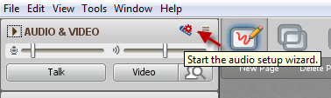
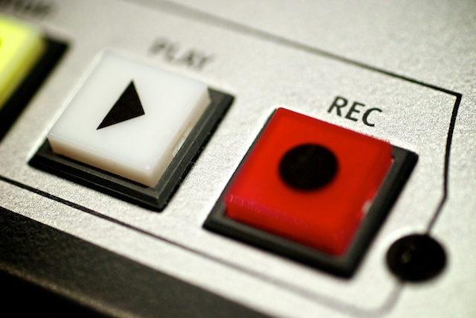
Lunch, learn, celebrate!
While you’re waiting…
Please run the audio setup wizard
Facilitators’ Development Workshop – November 2016
This session will be recorded…

Slide 2
Agenda
Who is here?
FDO – what do you know?
About the FLO family of workshops
Looking back, looking forward

Slide 3
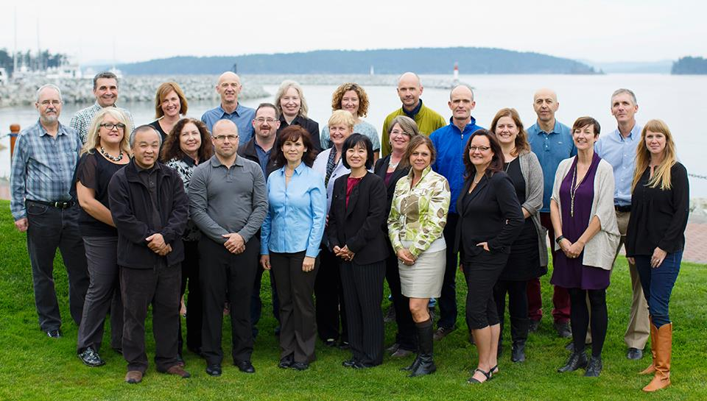
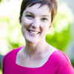
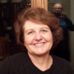
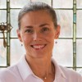
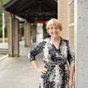
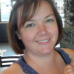

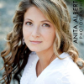

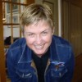
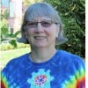
Beth – RRU
Cheryl - VCC
Suzanne - RRU
Marti - KPU
Rachel - COTR
Ross - OKAN
Viviana - CHHA
Mary - BCIT
Leonne - UFV
Sylvia - BCC

Slide 4
Quiz time! ✔or ✖
FDO prepares faculty to teach the Facilitating Learning Online workshop
Once the FDO workshop is over there is nothing left to learn about facilitation
FDO is a workshop for people who have never taken an online course
FDO facilitators mostly lecture and give exams
FDO participants are invited back for future FDO workshops
Notes:
For BCcampus folks – just for fun

Slide 5
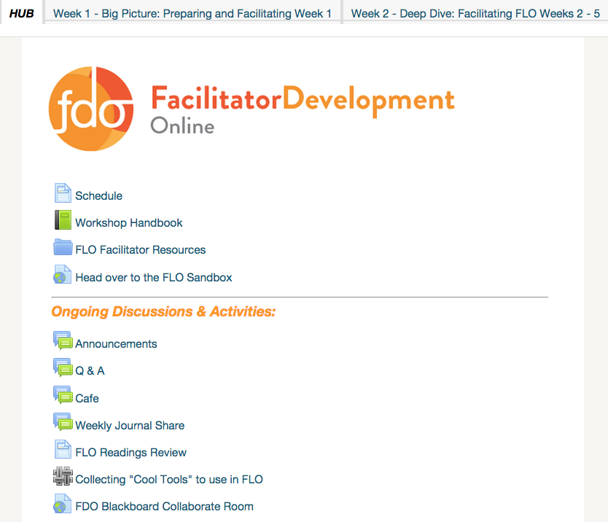
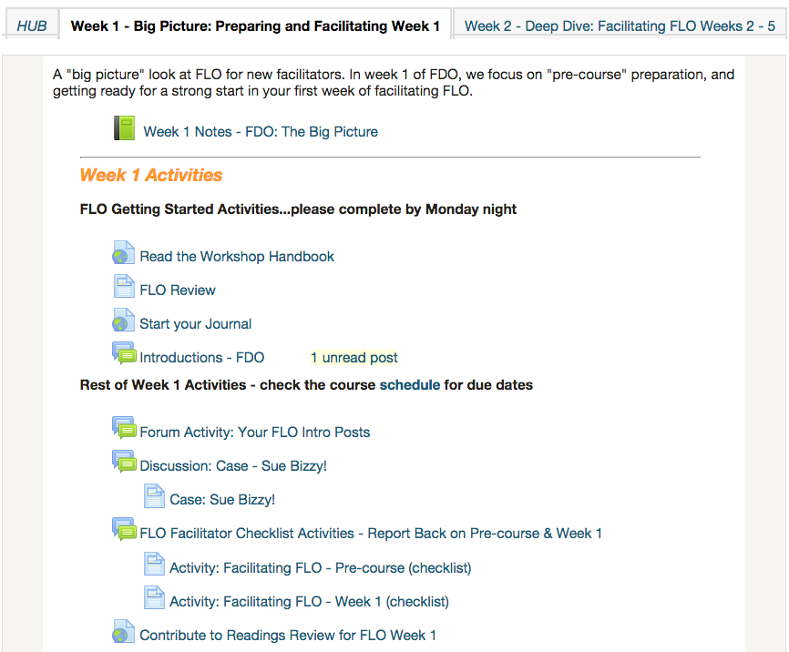

Slide 6


Focus module: Synchronous
Companion Workshop - Facilitating Learning: Design Focus
Focus module: Assessment
Focus module: ???
Notes:
Foundational workshops
Design workshop in the development stage

Slide 7
How is your FDO experience?

Slide 8

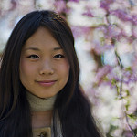
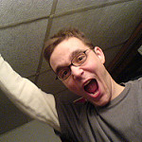


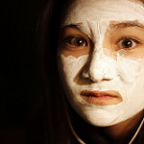
How is your FDO experience?
Image by Trey Ratcliff on Flickr - CC
Image by Munir Squires on Flickr - CC
Image by tim on Flickr - CC
Image by acearchie on Flickr - CC
Image by Alec Couros on Flickr - CC
Image by Cass Chin on Flickr - CC
Notes:
WHO: [Beth Cougler Blom]
WHAT: Lead FDO participants through a reflective activity. Doesn’t have to be turn taking with the mic. e.g.) Draw on whiteboard? Quick ABC survey? Circle a photo that describes how you feel then offer 1 or 2 to share more details?

Slide 9
Next steps?
What will you do with what you’ve learned?
What could you inspire at your institution?

Slide 10
Are You Ready?
Do you feel ready to co-facilitate a FLO?
Do you feel ready to help your institution host their own FLO?

Slide 11
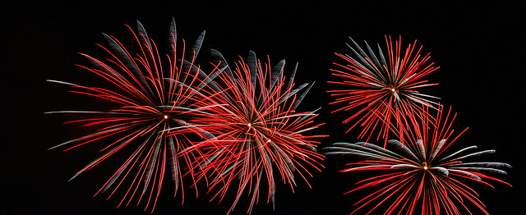
We’re almost there!
Notes:
‘Fireworks’ by Jdmoar – public domain https://flic.kr/p/oom57k

