Slide 1
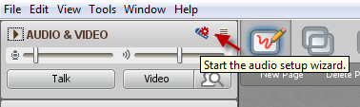
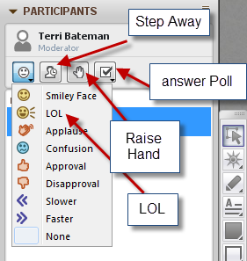

FDO Week 1: Big Picture
While you’re waiting…
Please run the audio setup wizard
Facilitator Development Workshop – March 2015
This session will be recorded…

Slide 2

Agenda
How did Week 1 go?
Facilitator Discussion Questions
Collecting More Questions
Notes:
https://flic.kr/p/gPDiDL The Big Blue by Salva Barbera

Slide 3
Facilitator Discussion:
Adjusting on the fly
Sometimes, enrolment doesn’t work out exactly as you’d hope (i.e., exactly 8-10 people).
How to adjust for high/low numbers?
What is the impact of attrition on participants? On the FLO facilitators?

Slide 4
Facilitator Discussion:
How messy should learning be?
“I’m so frustrated”
“I’m going to withdraw. This is overwhelming”
“It was SO MUCH WORK but we did it!!!”

Slide 5
Facilitator Discussion:
Modelling
Are we doing a good job of that during Week 1? (responsiveness, crafting posts, writing inclusively, clear instructions…)

Slide 6
Facilitator Discussion:
Balancing tech, design, and FACILITATION
How much of the FLO should be about using technologies outside of the LMS?
Is suggesting that participants design an activity too much?

Slide 7
Facilitator Discussion:
Work-Life Balance Topic
What are your perspectives? Is it worth doing?
How? As a mini-session?

Slide 8
Facilitator Discussion:
Is there a better way to do X?
“Cool Tools” in FLO and FDO – Moodle wiki or glossary, external wiki? (what’s the ideal approach?)
Revising and refining… Workshop content as an open educational resource
What else…

Slide 9
Collecting More Questions
What specific questions do you need answers to?
What specific issues do you want to discuss?

