Slide 1
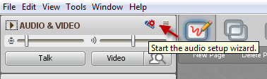

Welcome to the FDO!
While you’re waiting…
Please run the audio setup wizard
Facilitator Development Online – May 2016
Kickoff Session
This session will be recorded…

Slide 2
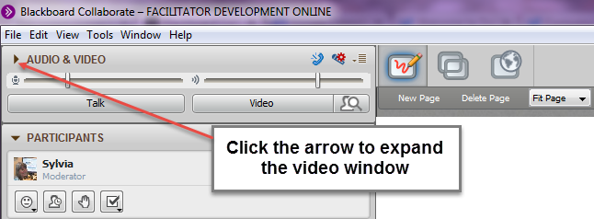

Quick Tech Tips
Use sliders to adjust volume
Click to talk, click when finished
Notes:
You’ll find the “arrow” beside each module – Chat, Participant List etc.

Slide 3

Agenda
Intros
Quick Collaborate Warm-up
FDO Site check-in
Journals – Your changing focus
What’s New - FLO
Collecting Your Questions
Facilitator Discussion Questions

Slide 4
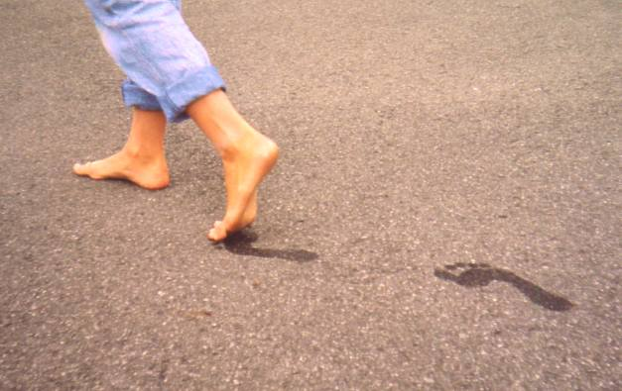
Intros & Tech Check
Who and where are you?
Tell us about your FEET!
  What are you wearing on your feet?
  Where do your feet take you?
http://en.wikipedia.org/wiki/File:Healthy_feet.JPG

Slide 5
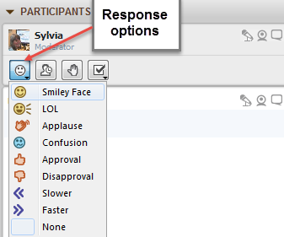
Quick Collaborate Warm-up
What kind of a day is it for you, so far?
Are you happy and you know it?

Slide 6
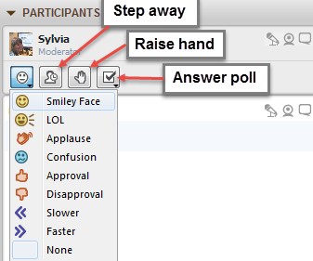
Quick Collaborate Warm-up
Have you looked around the FDO course site already?
(Yes or No )
When did you last moderate a live web
conferencing session?
  Earlier today
  Last week
  A month or more
  Never

Slide 7
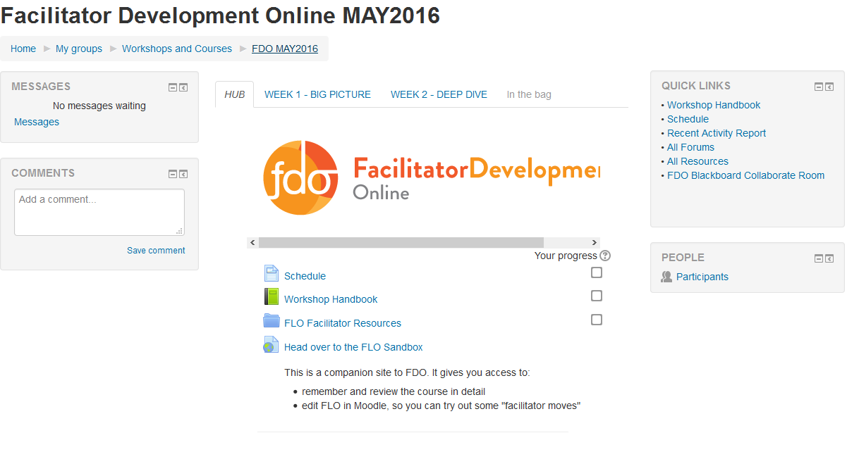
Notes:
Briefly point out Schedule use – make sure they have reviewed the tasks for Week 1
Navigation tips – Ask them to suggest the ways to move around the page (Breadcrumbs, tabbed pages, arrow keys at bottom of page)
Which do they prefer and why?
Explain how to send messages from Participants block
Quick review of value of Quick Links

Slide 8
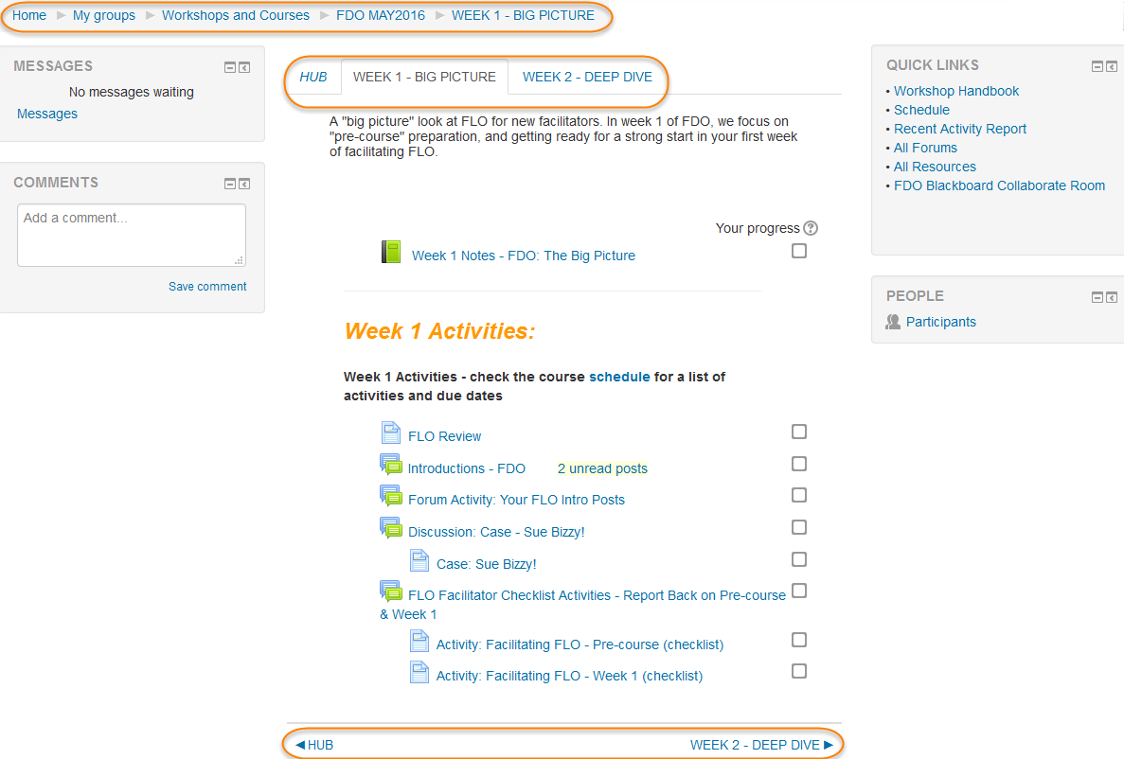

Slide 9
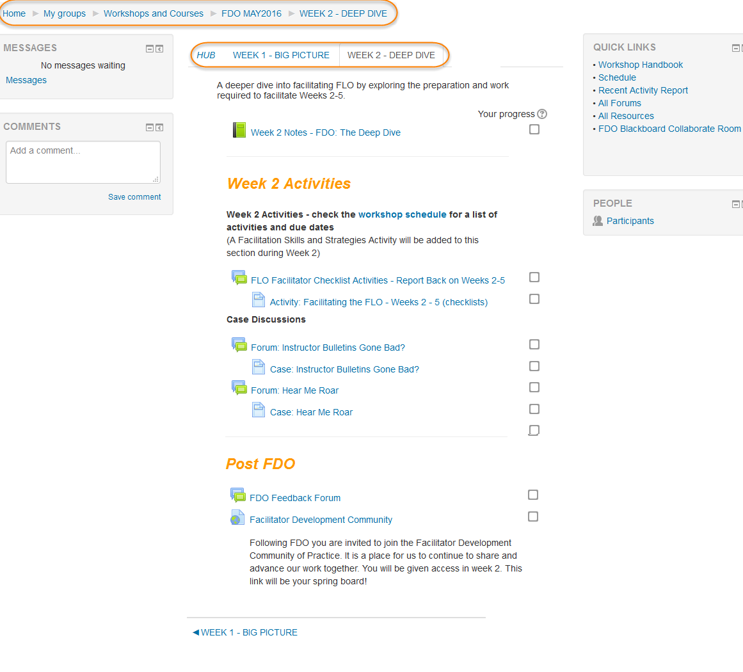

Slide 10

Your Learning Journal…
What format did you use in FLO?
What Format will you use in FDO?
Paper
Blog
Word doc
Google doc
Evernote
Other (what was it? Type it in…)
Paper
Blog
Word doc
Google doc
Evernote
Other (what will it be? Type it in…)
Notes:
Quick review of their FDO Learning Journal – same setup or different for format?
Move onto next slides and look at the reflections focus suggested

Slide 11
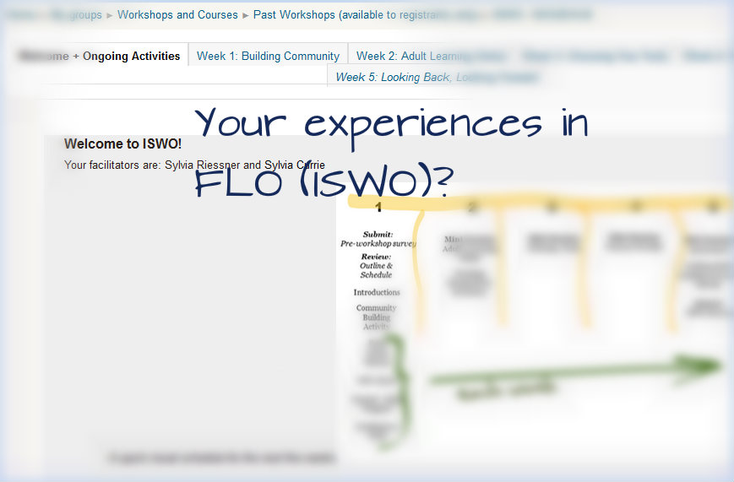
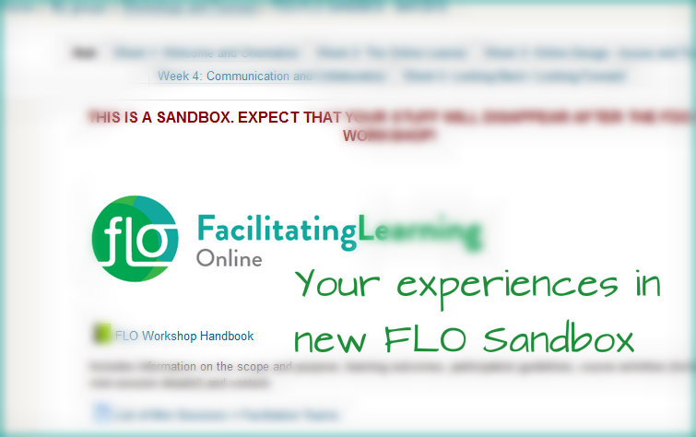
Notes:
Remind them of the information in FLO Overview about considering the FLO (ISWO) they took – and the new one they’ll see and work on in the Sandbox

Slide 12
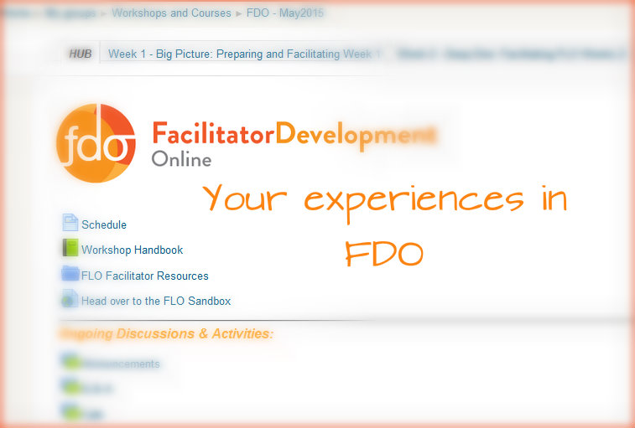
Notes:
And they should think about their learning as they proceed through the FDO

Slide 13
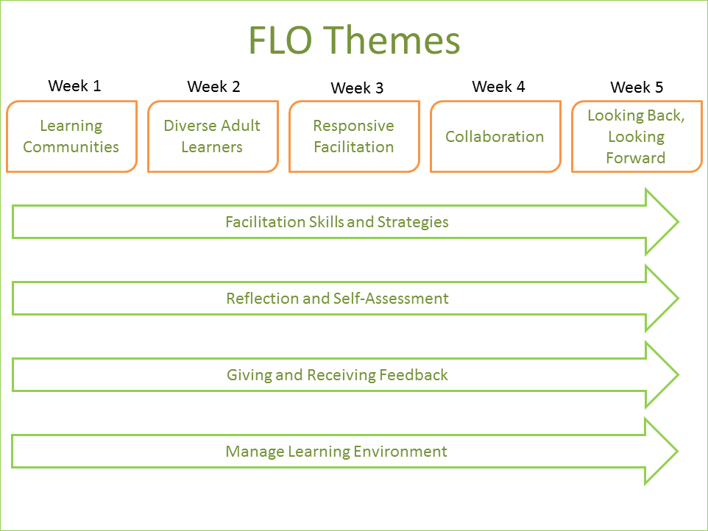
Notes:
What’s new about FLO Quick Overview of Design Sprint? Or just show visual schedule to show potential future changes too?

Slide 14
Collecting Your Questions
What specific questions do you need answers to?
What specific issues do you want to discuss?

