Slide 1
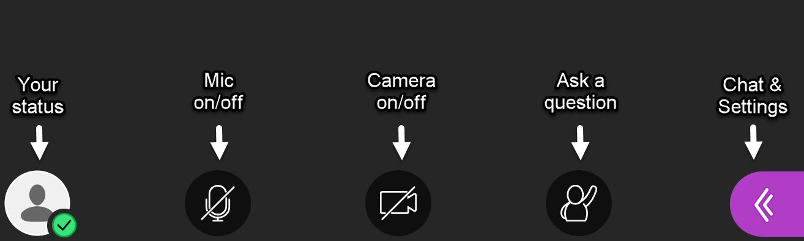
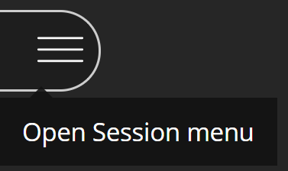
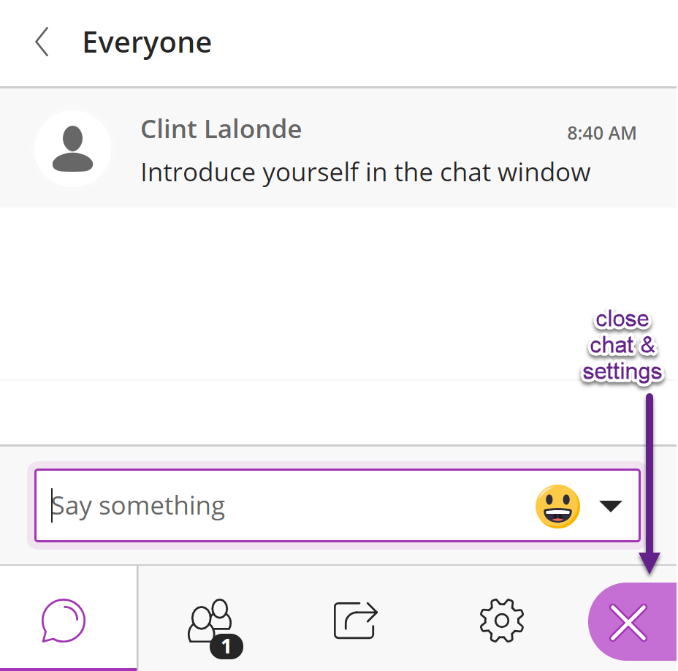
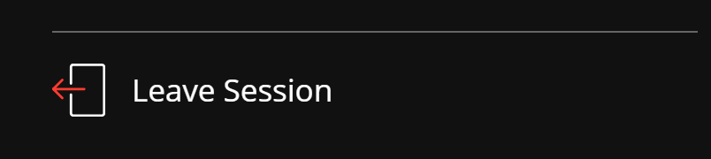
Welcome to Synchronous Basics!
Audio. Please keep off unless you wish to speak
Video. Camera off saves bandwidth & results in better experience
Chat & Settings panel
Introduce yourself in Chat. The chat is monitored, so feel to use it to ask questions during webinar
Use gear icon to set up audio & video and/or adjust your settings
Use participants icon to see others in webinar
Use the Session Panel (top left of your screen) to leave the webinar
Notes:
Should we move this slide up?When people enter the room, it might be nice to see this while waiting? HP I think so. Maybe just change collaborate to welcome - Ross

Slide 2
Land Acknowledgement
We acknowledge the traditional territory on which we are gathered today:
Unceded territory of the Squamish, Tsleil-Waututh and Musqueam Nations (Vancouver)
Traditional territory of the Lekwungen people (Songhees and Esquimalt Nations), and WSÁNEĆ (Saanich) (Victoria)
Type in the chat: where are you right now?
Notes:
Ask participants to type in the chat where they are from

Slide 3
Upcoming BCcampus Webinars
Tuesday April 21 Noon: Work Integrated Learning: Funding Streams & Opportunities amidst COVID-19
Friday April 24 Noon: Basics of Online Learning
Wednesday April 29 2pm: Coaching Event – The Impact of Powerful Questions
Subscribe BCcampus newsletter: bccampus.ca/subscribe

Slide 4
Agenda
Synchronous/Asynchronous Learning
Planning
Facilitating
Notes:
Purpose: why are we doing this?
As everyone pivots online, we want to support good and skilful (technically, and pedagogically) use of synchronous tools.
Using “live online” time in the best way. Avoid using live sessions for “content delivery”. Instead, using live sessions for interactions and activities to support learning
From George V’s recent publication:
5. Students want faculty to be comfortable with technology. There are many ways to teach remotely. Faculty should not assume that all teaching must be done via a live lecture. The most common tweets from students involve complaints that professors try to use technology that they clearly have not practiced, lecture for some time before realizing they were muted, show whiteboards upside-down, and don't notice when students tell them that something is wrong. If faculty are going to lecture, one way to avoid these problems is to simply record the lecture and ask students to watch it on their own time. Recording lectures in short five- or ten-minute chunks may provide added flexibility. Or if faculty want students to take notes, why not provide them with the PowerPoint file as a starting point? But most importantly, faculty should practice using technology before incorporating it into their classes.

Slide 5
On a scale of 0-5, how COMFORTABLE are you facilitating synchronous online sessions?
Make a mark on the line...
0
I can’t even…
(i.e., I am very UNcomfortable)
🙅
5
Easy Peasy Lemon Squeezy!!
(i.e., I am very comfortable)
😎
Notes:
If no interactive whiteboard available: use chat to share numbers
If in BlueJeans or another tool with a robust/interactive whiteboard, invite folks to make a mark directly on the line.

Slide 6
Synchronous & Asynchronous Learning

Slide 7
 | Synchronous | Asynchronous
Definition | Require all those participating in the communication to participate together, at the same time. | Enable participants to access information or communicate at different points of time, usually at the time of choice of the participant.
Examples | Live webinar/video conferencing Telephone conference calls Instant Messaging | Discussion forum Email Pre-recorded video lecture Course Readings Podcasts
Advantages | Connection Immediacy Increased emotional attachment | Flexibility Learner has more control Time to think
Disadvantages | Resource intensive (bandwidth) Scheduling Inclusivity & Accessibility Technical challenges are live | Activities take longer More difficult to develop community Lack of instant feedback
Bates, T. (2011). Models for selecting and using technology: 4. Synchronous or asynchronous? Retrieved from https://www.tonybates.ca/2011/06/29/models-for-selecting-and-using-technology-4-synchronous-or-asynchronous/
Notes:
What is synch and asynch? And why would you use one vs. the other?

Slide 8
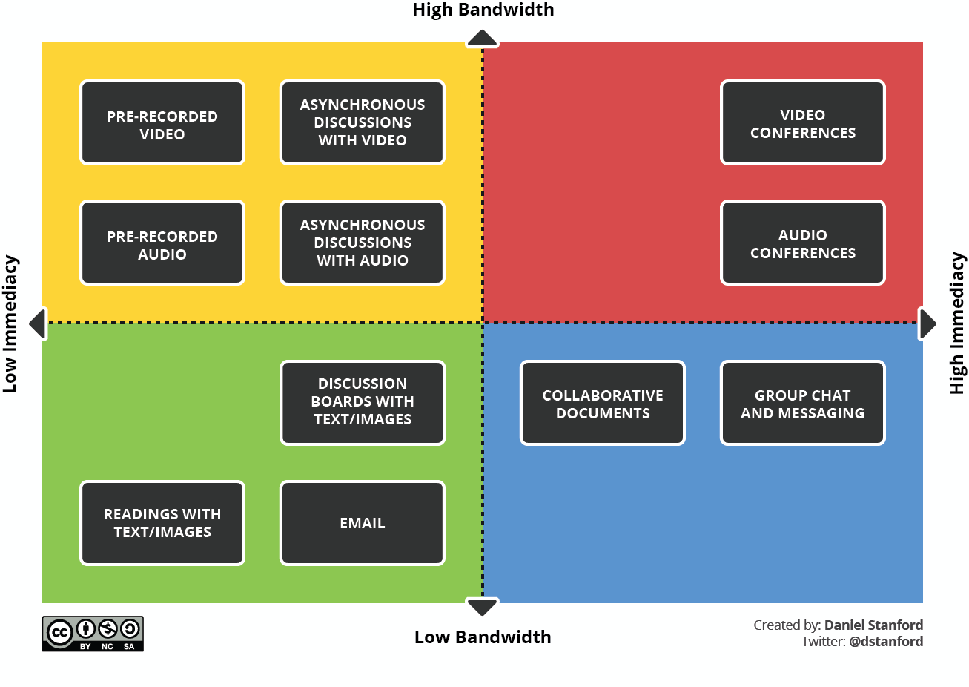
What does Bandwidth have to do with this?
Notes:
https://www.iddblog.org/videoconferencing-alternatives-how-low-bandwidth-teaching-will-save-us-all/
Note: bandwidth can present a barrier for some students

Slide 9
Planning Synchronous Sessions

Slide 10
Elements of Synchronous Plan
Define purpose & objectives
Think interactivity
Plan your time
Assign roles
Notes:
Large group discussion

Slide 11
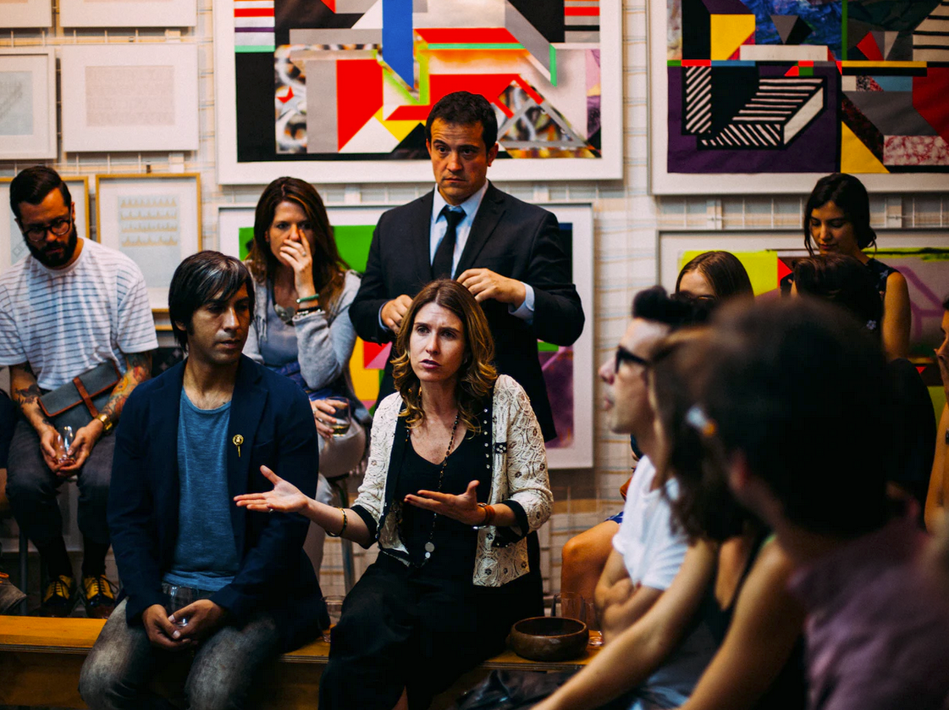
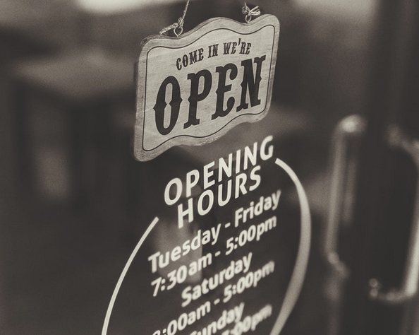

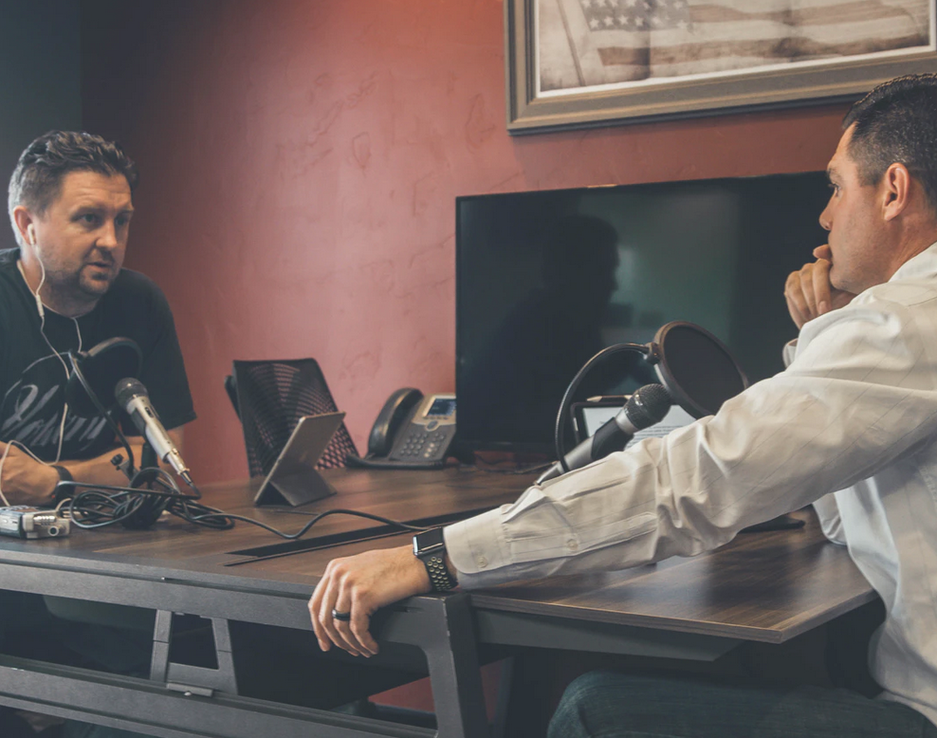
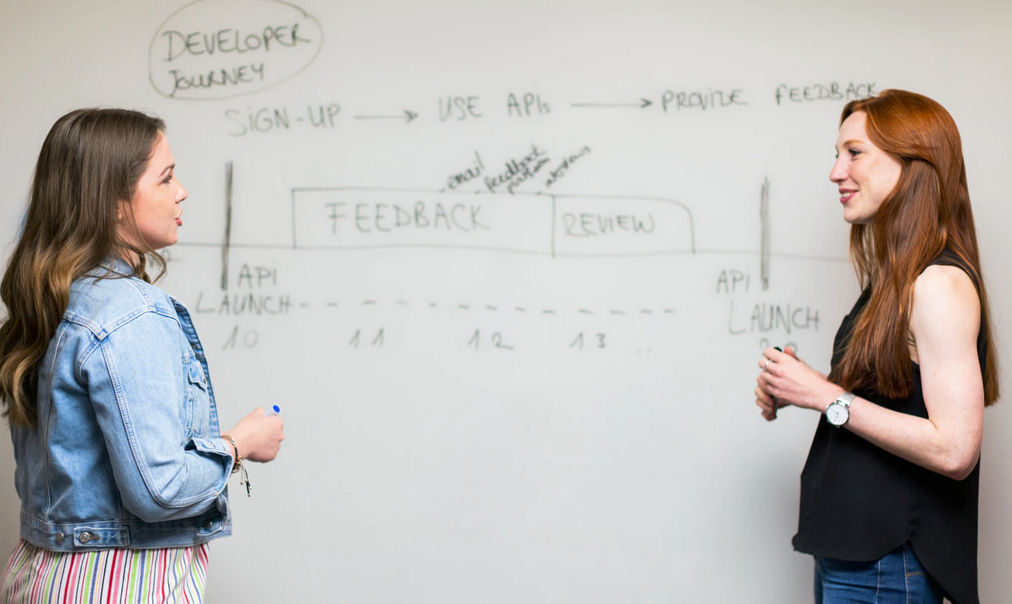
Purpose
Virtual Office Hours
Build Community & Connection
Class discussion
Guest Speakers
Collaborative Whiteboard
Notes:
Note about lecturing online: it’s SO much better to offer this kind of content as a pre-recorded video instead of a live talk. It’s more accessible (captioned), students can play and re-play it, it’s safe from unexpected technical difficulties in the moment

Slide 12


Slide 13
Before we talk interactivity, let’s talk tools

Slide 14






Tools (honestly, it doesn’t really matter)
What do you have access to (and tech support for?)
What functionality do you NEED to support students’ learning experiences?
Notes:
Poll

Slide 15
Think Interactivity
Tool | Description | Example
Chat | Allows participants to type messages and send them to other participants, the facilitator, or the entire class. | Assign learning partners to have a private chat where participants share the most important take-away they learned during the session.
Whiteboard | Offers space for brainstorming and group writing or drawing. | Draw a grid on the whiteboard and assign a square to each participant. Have participants draw a picture to review a key idea presented during the session.
Annotation | Allows participants to mark up the PowerPoint slide or whiteboard with a virtual drawing pen or other marks such as a check or an “X” | Display a PowerPoint slide with a multiple choice question. Ask participants to answer the question by making a mark next to their choice(s).
Poll | Asks participants to answer one or more questions. You can choose whether or not to share the results. | Quiz participants on any pre-work assignments.
Breakout Rooms | Allows for multiple, simultaneous, small group interactions, separate from the main group. | Create practice exercises for groups of three: one person to practice, one person to partner, one to observe and report.
Application or Screen sharing | Displays to all participants a software application that’s open on the facilitator’s (or the sharer’s) computer | Have a participant share his or her application and demonstrate how to perform a task in an application
Notes | Allows participants to save typed notes for access after the event. | Ask participants to write in key ideas to remember.
Available as a PDF at: bit.ly/synchtools
Notes:
Large group discussion

Slide 16
Plan your time
Time | Length | Who | Facilitator Activities | Participant Activities | Notes & Resources
15 min prior |  | All | Load slides Welcome people as they come in Add timer to start | Entering room Tech check Orienting to space Add name & location (Chat) | Welcome orientation slide
2:00 | 3 | C | Land Acknowledgement Recording On Facilitators’ video on Acknowledge land we are on | Note their location (chat) | Acknowledgement slide Remember to note chat as interactive tool
2:03 | 3 | All | Introduction Agenda Introduce team and roles, why we are doing this, what we will be doing. |  | Agenda Slide
2:06 | 5 | R | How comfortable are you with synchro teaching? | Use whiteboard tool to mark on the line. | How Comfortable Slide (demo interactivity)
2:11 | 3 | C | Difference between Synch & Asynch |  | Synch can become asynch thru recording live events

Slide 17
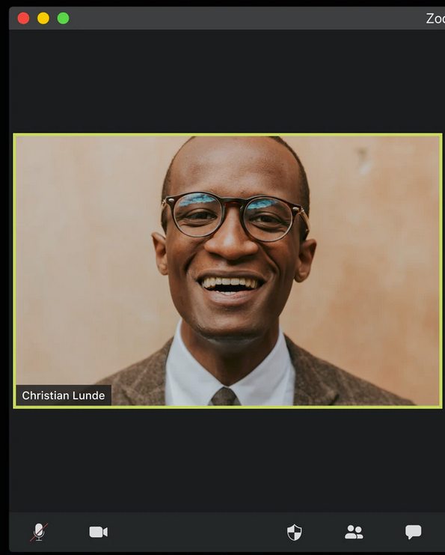
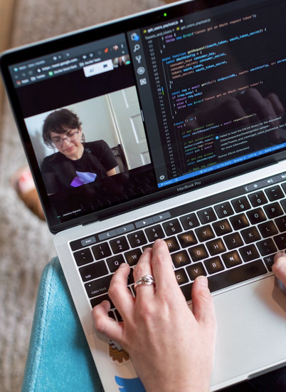
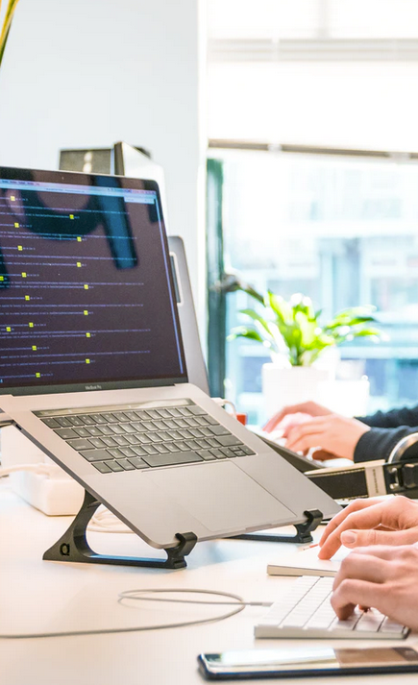
Roles
Facilitator(s)
Chat Moderator
Tech Support
Notes:
Can be students

Slide 18
What questions do you have?

Slide 19
Facilitating Synchronous Learning

Slide 20
Facilitating your Session
Session Lead Up — arrive early and be ready, especially technically!
Session Opening — confident & warm welcome, turn your video on
Purpose and Objectives - briefly address; consider an agenda
Active, participatory learning — keep them awake and engaged; use names
Interactivity!
Technical Skill and Comfort — avoid too many tools, make sure participants know how to use tools, back-up plan?
Visual and Technical Resources (slide decks, different modes, headset)
Session Closing — wrap-up activity/check out; stop recorder
Notes:
This is a run through of what a live session entails (summarized from FLO synchro... ) feel free to delete, but it might be good to walk them through it after “Avoid these things” HP Picture of facilitator with headsets?

Slide 21
Practical Facilitation Tips
Use headset or earbuds to prevent the “loop”
Limit use of cameras — bandwidth heavy
Mute audio for everyone, unless they are speaking
Orient students to the platform
Have low stakes icebreaker activity
Look into camera when speaking
Plan, but be flexible
Arrive early and connect with people as they arrive
Avoid playing audio/video in session

Slide 22
What questions do you have?
Unless otherwise noted, copyright-free images used in this presentation from Unsplash and Pexels

